Slide 1



T
INTRODUCTION
Hi, I'm Mahima Pathania – a curious and driven junior analyst, fueling my curiosity to uncover impactful insights. With a passion for problem-solving and data exploration, I aim to turn numbers into stories and pave the way for innovation.

Slide 2

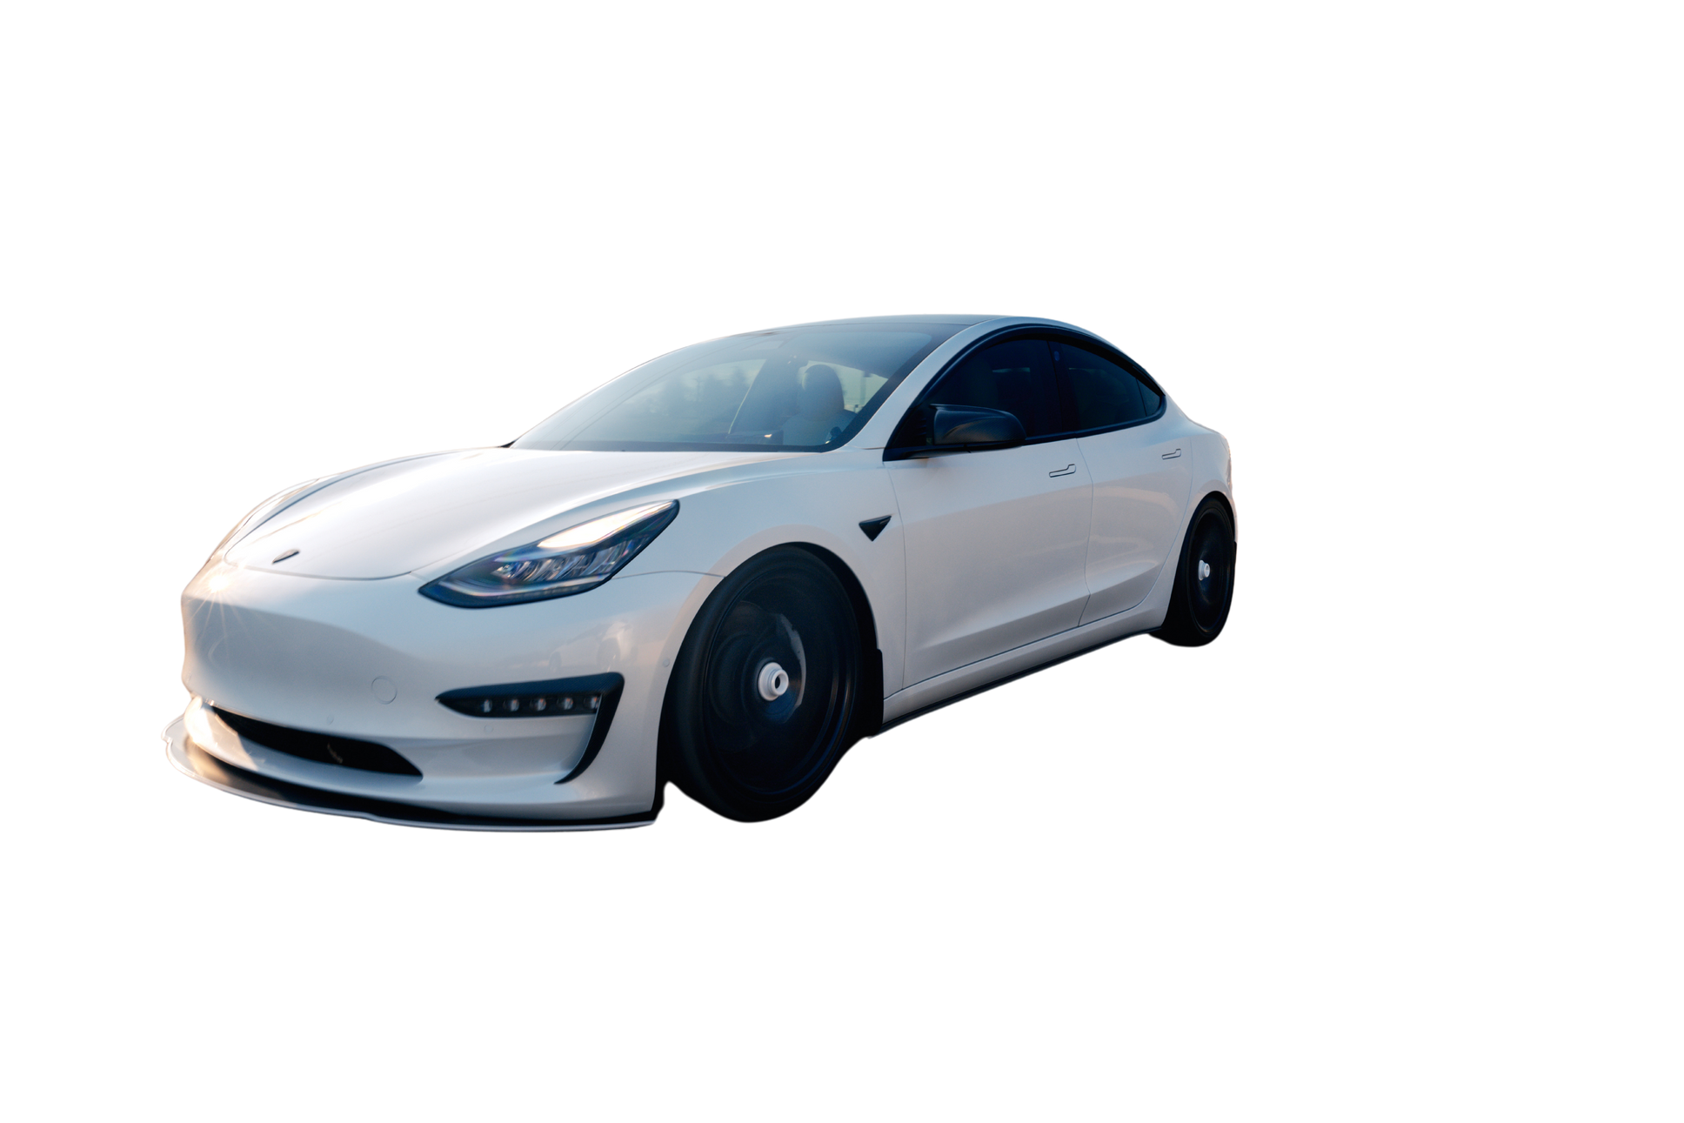
ELECTRIC VEHICLES
ANALYSIS
USING SQL QUERIES
Let's use data and SQL to analyze trends and drive a greener future with electric vehicles.
Presented By: Mahima Pathania

Slide 3
KEY TOPICS
Problem Statement
Objective
Dataset
Process
Result
Recommendations

Slide 4
PROBLEM STATEMENT
AtliQ Motors is an automotive giant from the USA specializing in electric vehicles (EV). In the last 5 years, their market share rose to 25% in electric and hybrid vehicles segment in North America. As a part of their expansion plans, they wanted to launch their bestselling models in India where their market share is less than 2%. Bruce Haryali, the chief of AtliQ Motors India wanted to do a detailed market study of existing EV/Hybrid market in India before proceeding further. Bruce gave this task to the data analytics team of AtliQ motors.

Slide 5
OBJECTIVE
As a Data Analyst, working on this project, my objective was to analyze the Indian EV and hybrid vehicle market, provide actionable insights on market trends, and identify opportunities for scaling operations. This required working with large datasets and delivering key recommendations to Bruce Haryali and the leadership team.

Slide 6
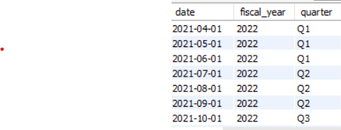
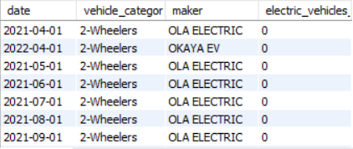
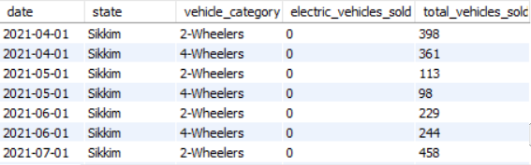
DATASET
dim_date
electric_vehicles_sold_by_makers
electric_vehicles_sold_by_states

Slide 7
.
PROCESS
Addressing Irregularities: The date column across multiple tables had inconsistencies in naming conventions, making it necessary to rename the column to use during the analysis .
Data Type Transformation: The date column's data type was transformed from text to date format in all the three tables.
Query Optimization with Views: Optimize query performance, several views were created to reduce redundant joins and provide on-the-fly results. This improved efficiency. The key views created are:
dim_state: Joins data between dim_date and state.
dim_makers: Joins data between dim_date and makers table.

Slide 8
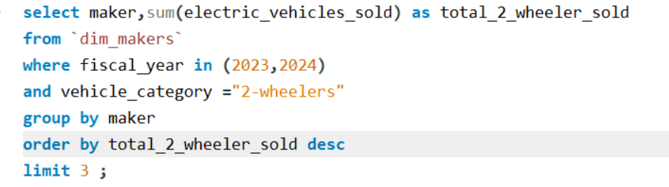
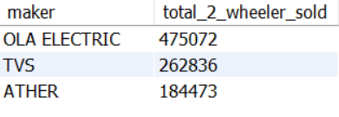
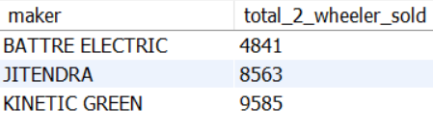
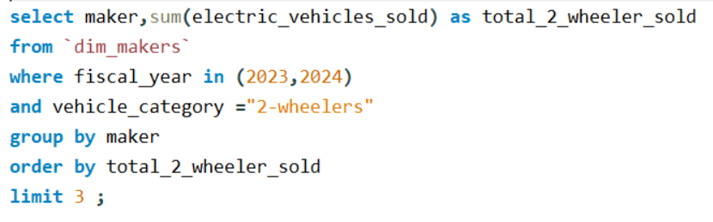
Answering Questions with SQL Analysis
List the top 3 and bottom 3 makers for the fiscal years 2023 and 2024 in terms of the number of 2-wheelers sold.

Slide 9




You have to proof me how much you love me?
You don’t know how much I LOVE YOU . Even I Can count stars for you have a look .

Slide 10


It’s how much a product is being used compared to the total number of possible users in the market.
For example, if 100 million people own vehicles in India and 10 million own an EV, the EV penetration rate is 10%. It shows how popular electric vehicles are compared to all vehicles.
Hey, what does penetration rate mean?

Slide 11
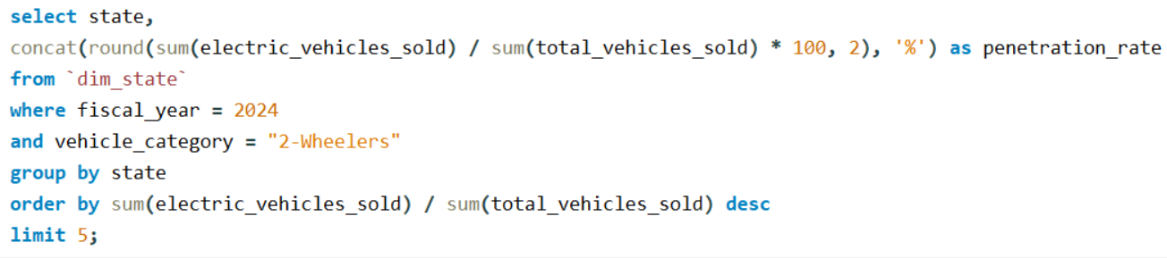
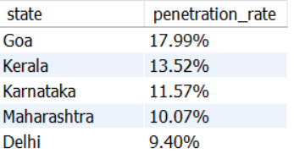
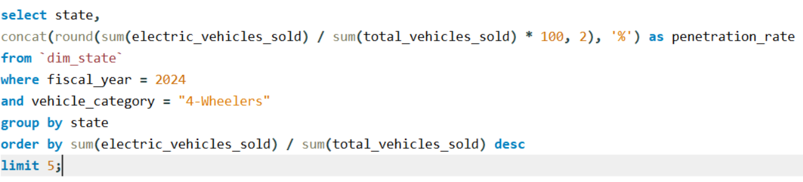
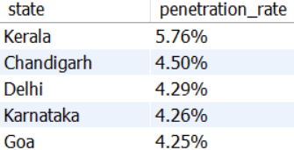
Identify the top 5 states with the highest penetration rate in 2-wheeler and 4-wheeler EV sales
in FY 2024.
For 2-Wheeler
For 4-Wheeler

Slide 12
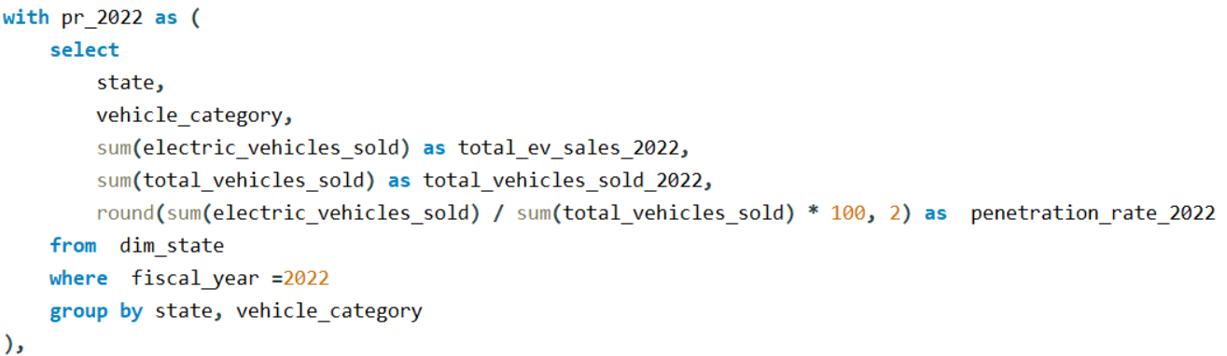
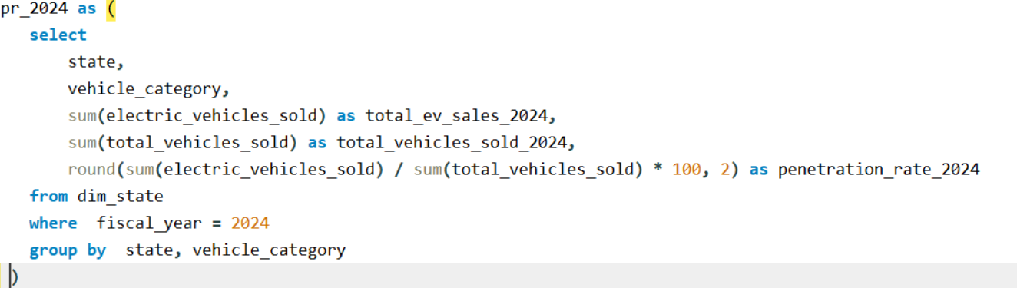
3. List the states with negative penetration (decline) in EV sales from 2022 to 2024?.

Slide 13
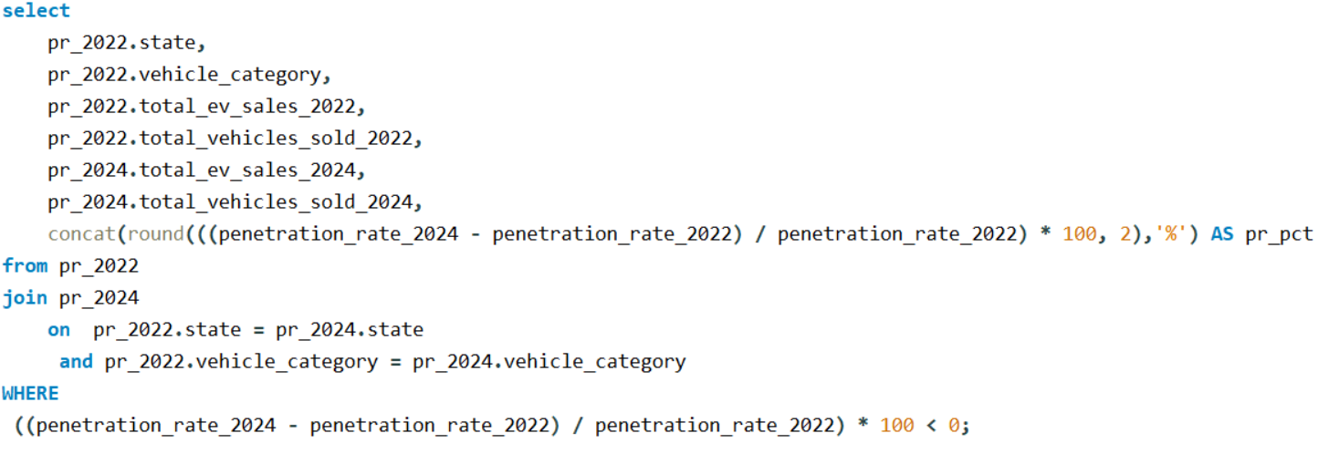

Slide 14
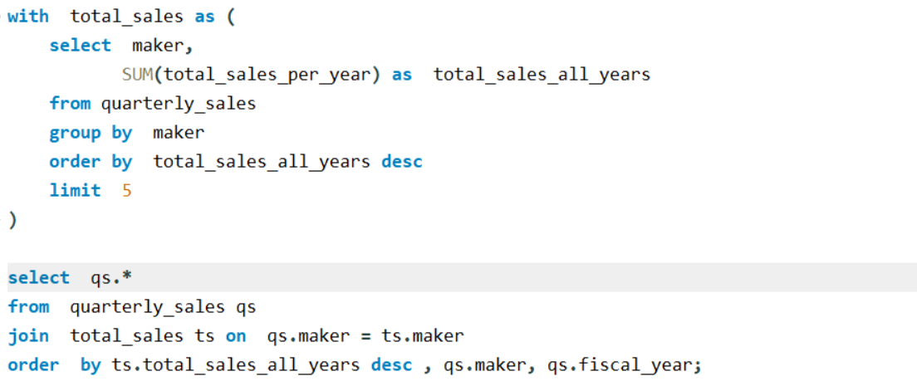
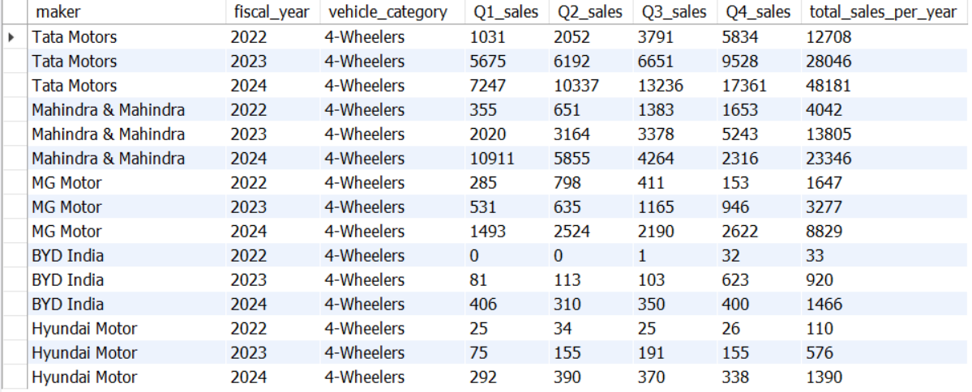
4. What are the quarterly trends based on sales volume for the top 5 EV makers (4-wheelers) from
2022 to 2024?

Slide 15
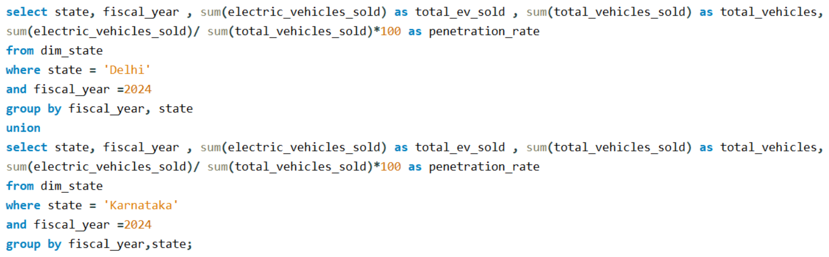
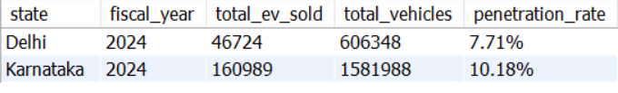
5. How do the EV sales and penetration rates in Delhi compare to Karnataka for 2024?

Slide 16







CAGR tells us how fast something grows over time in a steady way. It’s used to measure the yearly growth rate of a business, investment, or market.
For example, if EV sales were 10,000 units in 2020 and 25,000 units in 2025, CAGR helps calculate the average yearly growth rate over those five years
Hope , It helps!
Hey, what does CAGR mean?
Hurray, I got it .

Slide 17
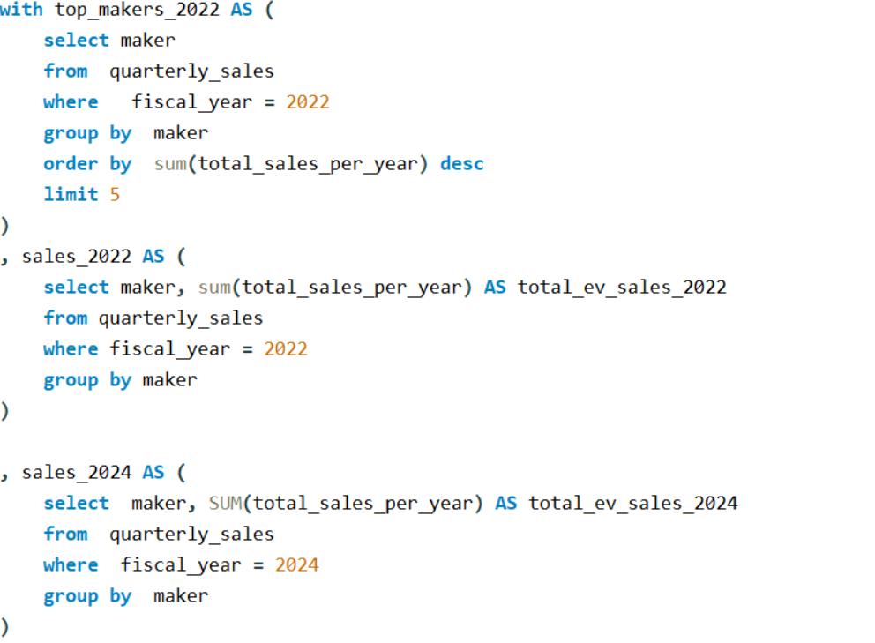
6. List down the compounded annual growth rate (CAGR) in 4-wheeler units for the top 5 makers
from 2022 to 2024?

Slide 18
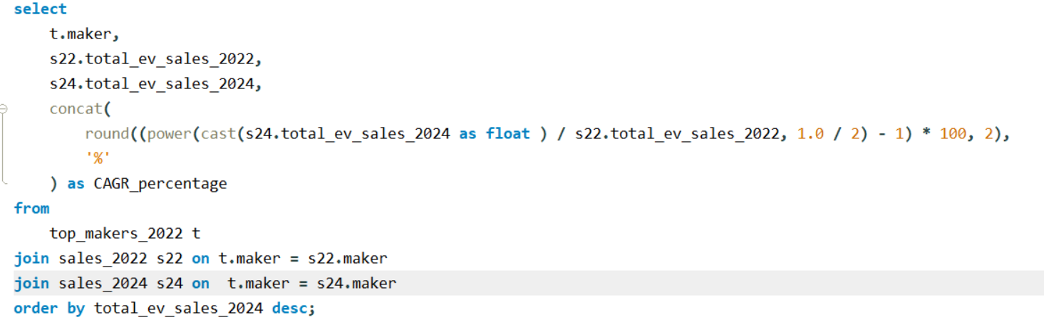
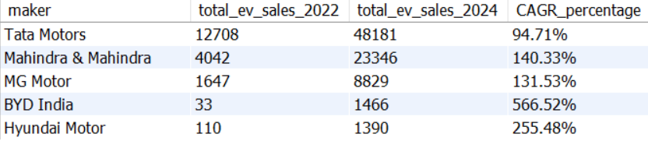

Slide 19
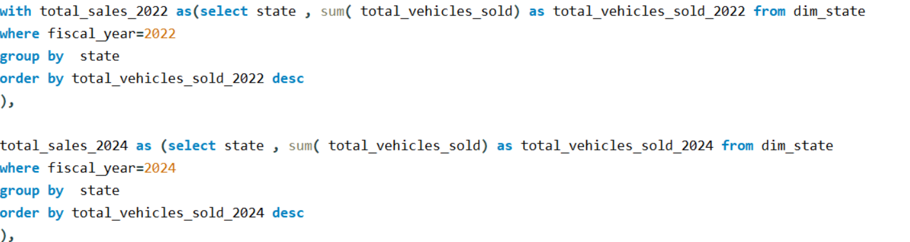
7. List down the top 10 states that had the highest compounded annual growth rate (CAGR) from
2022 to 2024 in total vehicles sold.

Slide 20
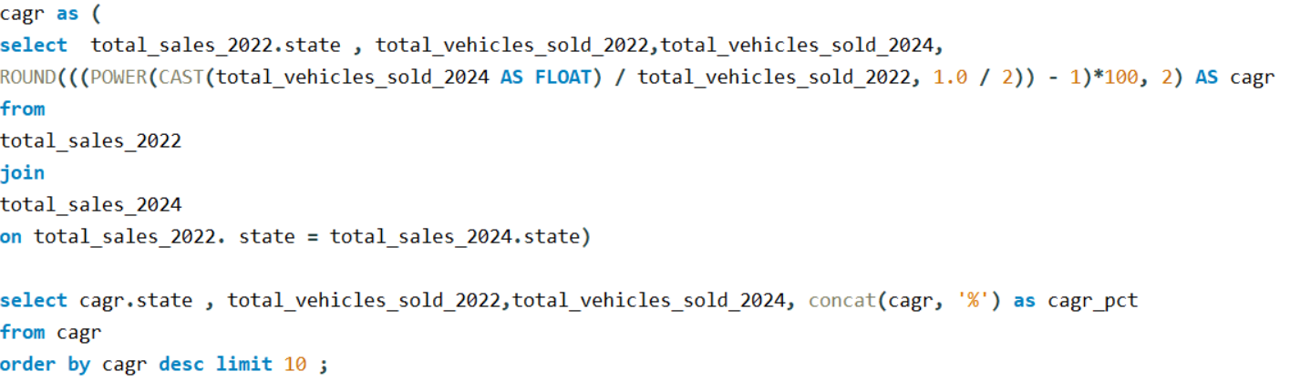
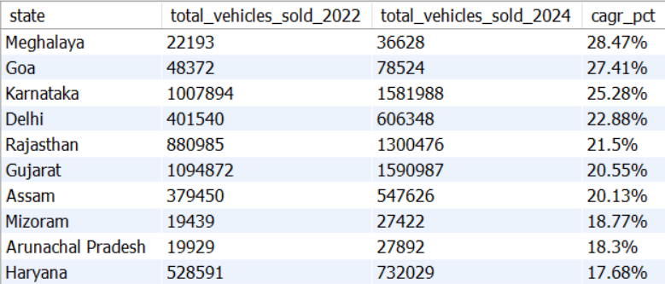

Slide 21
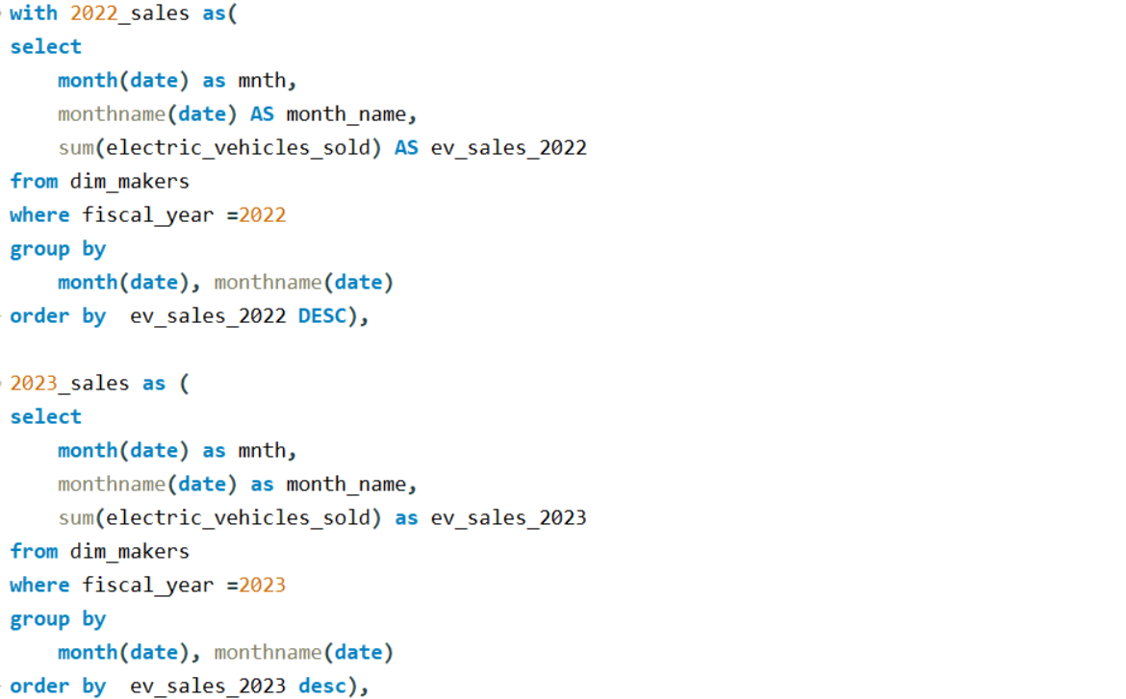
8. What are the peak and low season months for EV sales based on the data from 2022 to 2024?

Slide 22
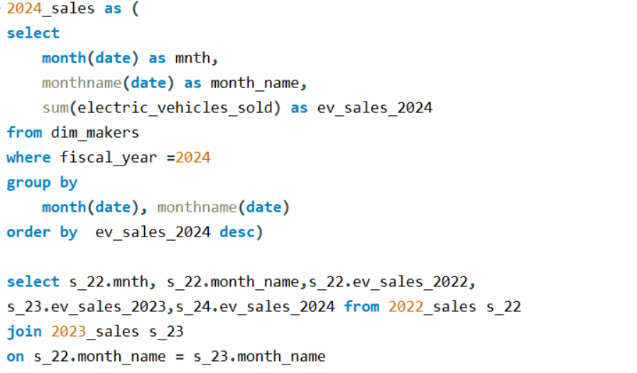
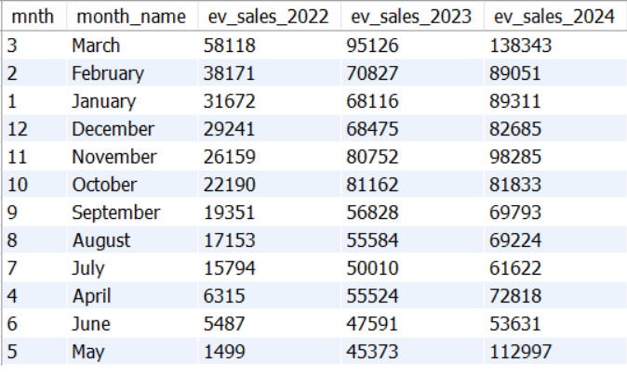

Slide 23
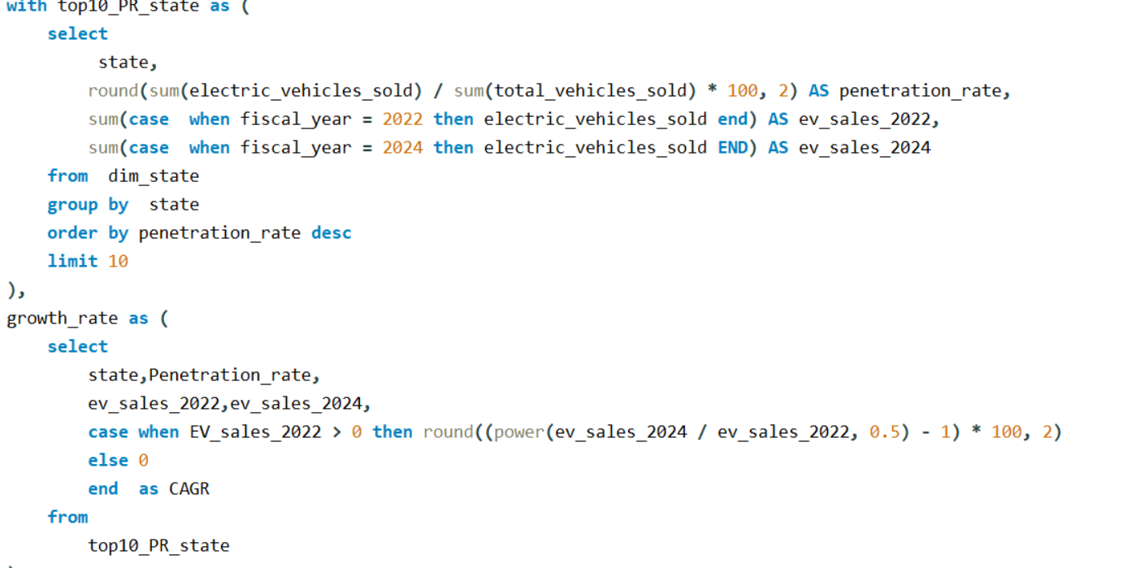
9. What is the projected number of EV sales (including 2-wheelers and 4- wheelers) for the top 10 states by penetration rate in 2030, based on the compounded annual growth rate (CAGR) from previous years?

Slide 24
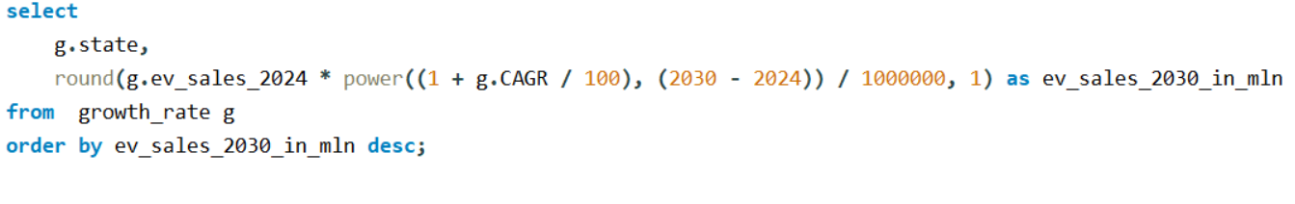
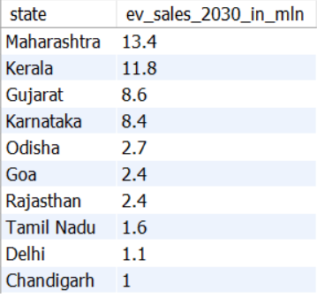

Slide 25
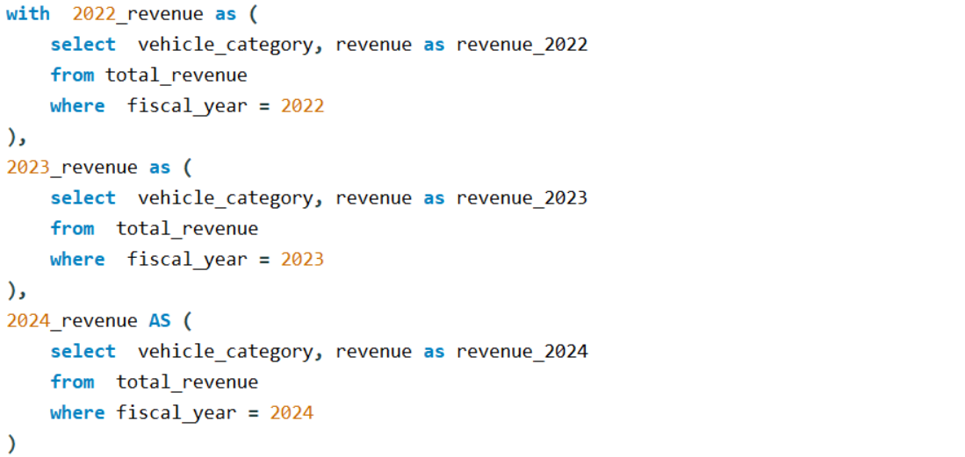
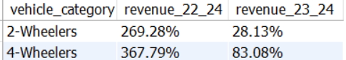
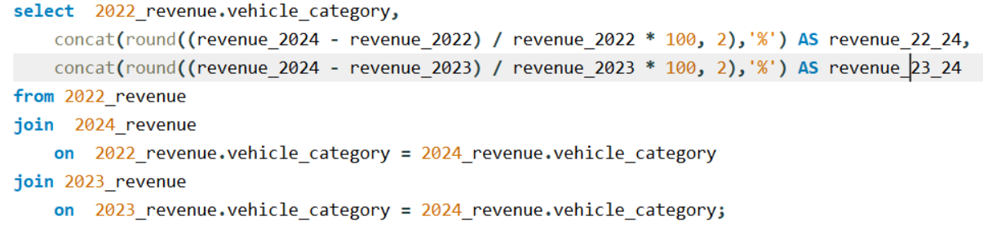
10. Estimate the revenue growth rate of 4-wheeler and 2-wheelers EVs in India for 2022 vs 2024 and 2023 vs 2024, assuming an average unit price.

Slide 26
RecommendatIonS
Pricing Strategy : Most EV makers (excluding Tata Motors) start their pricing at ₹16 lakh, whereas Tata Motors offers variants starting from ₹10 lakh.
To appeal to Indian consumers, AtliQ Motors should introduce two variants—one for the premium segment and another for the middle-class market, ensuring affordability and wider adoption.
Manufacturing Unit & Launch Locations : Maharashtra: Ideal due to its port access and major automobile hubs like Pune, Mumbai, and Nashik.

Slide 27
Tamil Nadu: A leading automobile hub with established manufacturers like Hyundai, Ford, and BMW, offering strong infrastructure and skilled labor.
Brand Ambassador Selection: To align with sustainability and environmental consciousness, AtliQ Motors should consider Amitabh Bachchan, Dia Mirza, or Priyanka Chopra as brand ambassadors.
These celebrities have actively supported environmental causes, making them strong advocates for green mobility.

Slide 28


THANK YOU
www.linkedin.com/in/mahima-pathania.com
mahimapathania1405@gmail.com

